Slide 1
Reclassification Criteria for English Learners
Toluca Lake Elementary

Slide 2
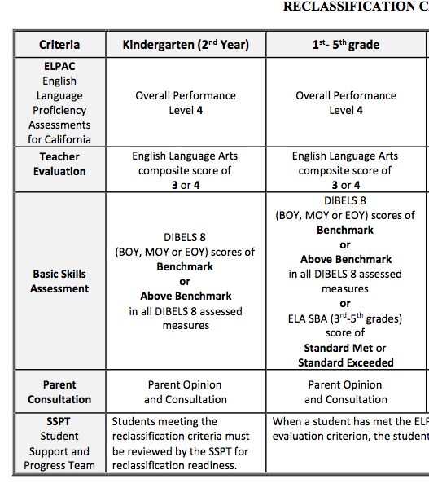
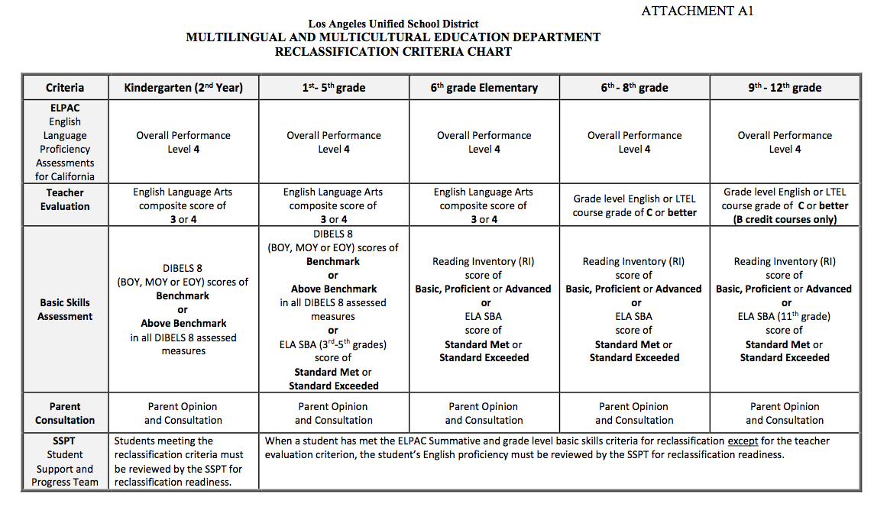

Slide 3
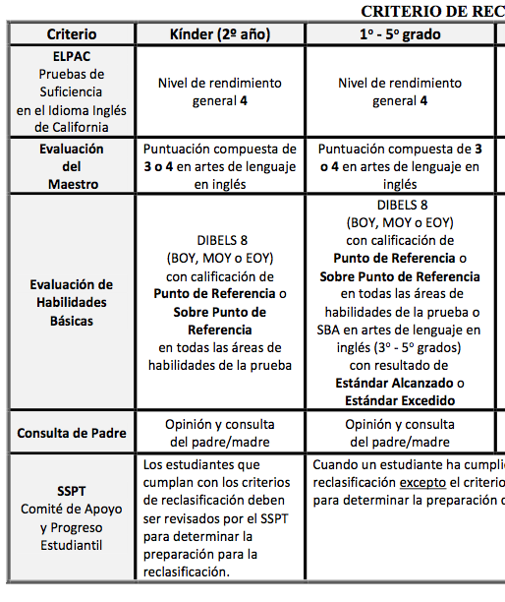
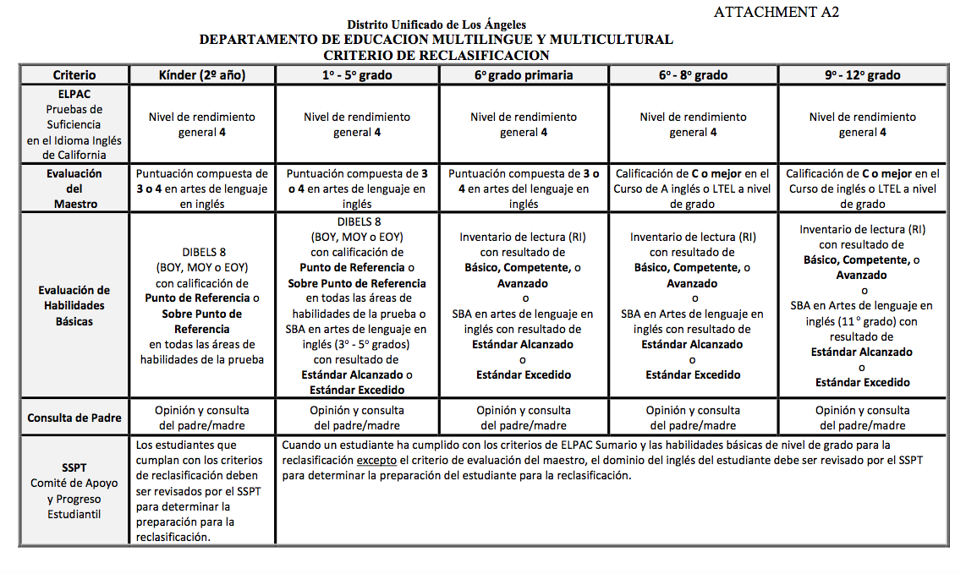

Slide 4
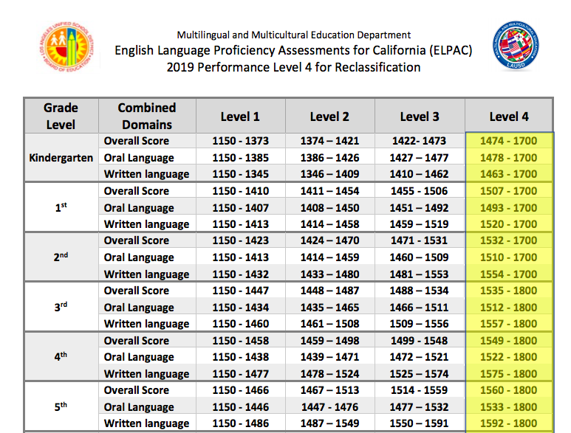

Slide 5
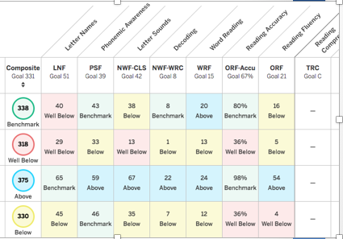
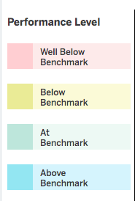
DIBELS

Slide 6
Grades
Calificaciones

Slide 7
Toluca Lake English Learner Profiles
EL Profile | # of Students
A | 0
B | 1
C | 0
D | 0
E | 0
F | 0
G | 3
H | 16
Total | 20
EL Profiles and Criteria Progress
Profile A | CELDT/ELPAC | DIBELS/RI/SBAC | GRADES
Profile B | CELDT/ELPAC | DIBELS/RI/SBAC | GRADES
Profile C | CELDT/ELPAC | DIBELS/RI/SBAC | GRADES
Profile D | CELDT/ELPAC | DIBELS/RI/SBAC | GRADES
Profile E | CELDT/ELPAC | DIBELS/RI/SBAC | GRADES
Profile F | CELDT/ELPAC | DIBELS/RI/SBAC | GRADES
Profile G | CELDT/ELPAC | DIBELS/RI/SBAC | GRADES
Profile H | CELDT/ELPAC | DIBELS/RI/SBAC | GRADES
LEGEND
Passed Criterion | GREEN
Failed Criterion | RED

Slide 8
Toluca Lake Profiles
EL Profile | # of Students
A | 0
B | 1
C | 0
D | 0
E | 0
F | 0
G | 3
H | 27
Total | 31
11 New EL’s were identified for 2019-2020.
NEW TOTAL= 31
11 students are Kindergartners
7 students are Newcomers
5 students are PLTELs
No Change in EL Level
for 3 Years!!

Slide 9
English Learner Programs
2018-19 Goal: By June 2019, 22% of EL students will reclassify.
As of June 2019, 5% of EL students reclassified.

